Slide 1
UPPER SIXTH ARTS
GEOGRAPHY
Lesson 12
The Demographic Transition Model
Notes:
Good morning, class, and welcome to our geography lesson. I am your geography teacher, Mr Kamdem. Today we are starting Lesson 12: The Demographic Transition Model.

Slide 2
CLASS INFO
Class, Chapter and Duration
Class | Upper Sixth Arts
Chapter | Module 4: Understanding and managing population dynamics across the world in general and Cameroon in particular
Duration | 2 periods (2 × 50 minutes)
Notes:
This lesson is for Upper Sixth Arts. It belongs to Module 4: Understanding and managing population dynamics across the world in general and Cameroon in particular. We shall need 2 periods to cover it.

Slide 3
IDENTIFICATION
Lesson Identification
Topic | Population Change over Time (Population Growth)
Sub-topic | Population Growth
Lesson | Lesson 12: The Demographic Transition Model
Notions / Concepts | Demographic transition model (DTM), high stationary, early expanding, late expanding, low stationary, declining, Rostow, natural increase.
Syllabus focus | Meaning of the DTM; its five stages with their demographic and socio-economic characteristics and examples; link with Rostow; appraisal; application to Cameroon.
Competence | Learners are able to describe the stages of the demographic transition model, appraise it and apply it to Cameroon.
Notes:
Our topic is Population Change over Time (Population Growth), and the sub-topic is Population Growth. The key notions we shall use today are: demographic transition model (DTM), high stationary, early expanding, late expanding, low stationary, declining, Rostow, natural increase. At the end, you should be able to do this: learners are able to describe the stages of the demographic transition model, appraise it and apply it to Cameroon.

Slide 4

HOMEWORK CORRECTION
Correction of the Homework
Question (Lesson 11: The Modern Demographic Explosion and Population Policies):
Name the five stages of the demographic transition model.
Notes:
Before we start the new lesson, let us correct the homework I gave you at the end of Lesson 11: The Modern Demographic Explosion and Population Policies. The question was: Name the five stages of the demographic transition model. Take out your exercise books.

Slide 5
HOMEWORK CORRECTION
Correction: Possible Answer
High stationary, early expanding, late expanding, low stationary and declining.
Notes:
Here is a good answer. High stationary, early expanding, late expanding, low stationary and declining. Compare it with your own answer and correct your work in red.

Slide 6
LESSON PLAN
Lesson Plan
Correction of the homework
Objectives and recall
Real-life situation and action to take
Learning activities
Board summary
Evaluation, remediation and homework
Notes:
Here is the plan of our lesson today. First, we shall correct the homework. Then we shall look at the objectives and recall what you already know. After that, we shall study a situation from real life and the action to take, and do the learning activities. Finally, we shall copy the board summary, do the evaluation and the remediation, and I will give you the homework.

Slide 7
OBJECTIVES
Objectives
By the end of this lesson, you should be able to:
Define the demographic transition model.
Describe the characteristics of its five stages.
Notes:
Take your time to copy this part; we will continue together.

Slide 8
OBJECTIVES
Objectives (continued)
Link the stages with Rostow's stages of economic growth.
Appraise the strengths and weaknesses of the model.
Apply the model to Cameroon.
Notes:
By the end of this lesson, you should be able to do five things. Number 1: define the demographic transition model. Number 2: describe the characteristics of its five stages. Number 3: link the stages with Rostow's stages of economic growth. Number 4: appraise the strengths and weaknesses of the model. Number 5: apply the model to Cameroon.

Slide 9
PREVIOUS KNOWLEDGE
Previous Knowledge
Death rates fell before birth rates.
Japan has negative growth.
Cameroon has high births and falling deaths.
Notes:
Let us first remember what you already know. Death rates fell before birth rates. Japan has negative growth. Cameroon has high births and falling deaths. Keep this in mind, because we shall build on it today.

Slide 10
REAL-LIFE SITUATION
Situation in Real Life
Maman Zara, an elder of the Mourgou quarter of Garoua, remembers that in her childhood families had eight to ten children because many died young.
Her own children have three or four children each, and almost all her grandchildren are healthy and go to school.
Notes:
Take your time to copy this part; we will continue together.

Slide 11
REAL-LIFE SITUATION
Situation in Real Life (continued)
The village now has a health post and boreholes.
Her grandson asks: "Is there a model that explains these changes in births and deaths, and what will happen to the population of Cameroon in the future?"
Notes:
Listen carefully to this situation from real life. Maman Zara, an elder of the Mourgou quarter of Garoua, remembers that in her childhood families had eight to ten children because many died young. Her own children have three or four children each, and almost all her grandchildren are healthy and go to school. The village now has a health post and boreholes. Her grandson asks: "Is there a model that explains these changes in births and deaths, and what will happen to the population of Cameroon in the future?" Think about it, because I am going to ask you some questions.

Slide 12
REAL-LIFE SITUATION
Situation: Question 1
What is the problem in the situation?
Notes:
Question 1: What is the problem in the situation? Think for a moment, then raise your hand to answer.

Slide 13
REAL-LIFE SITUATION
Answer
The grandson does not know the model that explains the change in births and deaths over time.
Notes:
Good. The grandson does not know the model that explains the change in births and deaths over time.

Slide 14
REAL-LIFE SITUATION
Situation: Question 2
What changed between the childhood of Maman Zara and today?
Notes:
Question 2: What changed between the childhood of Maman Zara and today? Think for a moment, then raise your hand to answer.

Slide 15
REAL-LIFE SITUATION
Answer
Deaths fell first, then births began to fall.
Notes:
Good. Deaths fell first, then births began to fall.

Slide 16
REAL-LIFE SITUATION
Situation: Question 3
What caused these changes?
Notes:
Question 3: What caused these changes? Think for a moment, then raise your hand to answer.

Slide 17
REAL-LIFE SITUATION
Possible Answer
Health posts, clean water and schooling.
Notes:
Good. Health posts, clean water and schooling.

Slide 18
ACTION TO TAKE
Action to Take
Use the demographic transition model to explain and forecast the population of Cameroon.
Notes:
From this situation, the action we are working towards in this lesson is the following: use the demographic transition model to explain and forecast the population of Cameroon.

Slide 19
JUSTIFICATION
Justification of the Lesson
This lesson helps us to understand how development changes population growth and to predict the future of Cameroon's population.
Notes:
Why is this lesson important for you? This lesson helps us to understand how development changes population growth and to predict the future of Cameroon's population.

Slide 20
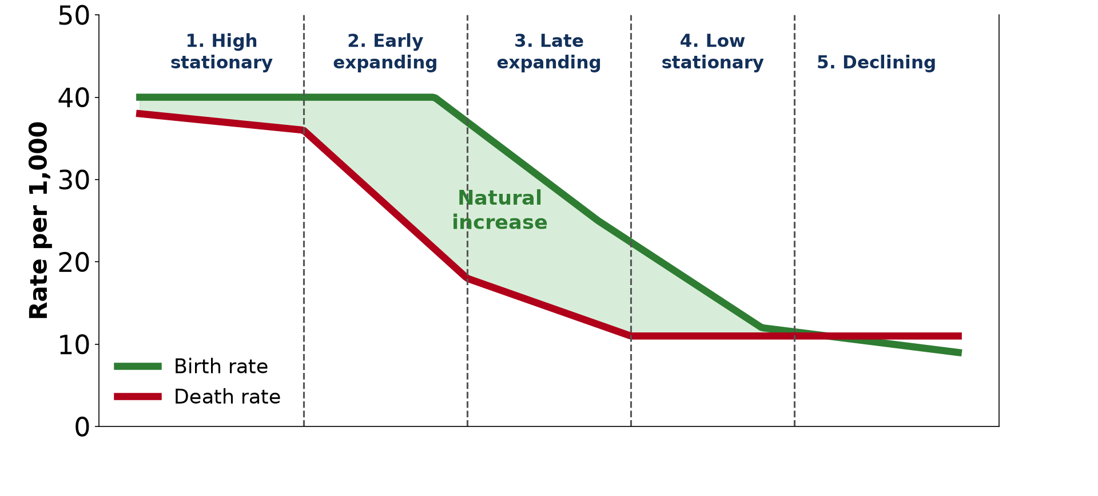
1. MEANING
Activity 1
The demographic transition model.
Notes:
Activity 1. Look carefully at this diagram: the demographic transition model. Observe every detail before I ask the question.

Slide 21
1. MEANING
Activity 1: Question
Which line falls first on the graph: births or deaths?
Notes:
Here is the question for Activity 1: Which line falls first on the graph: births or deaths? Take one minute to think and write your answer in your rough notebook.

Slide 22
1. MEANING
Activity 1: Answer
The death rate.
Notes:
Let us check the answer together. The death rate.

Slide 23
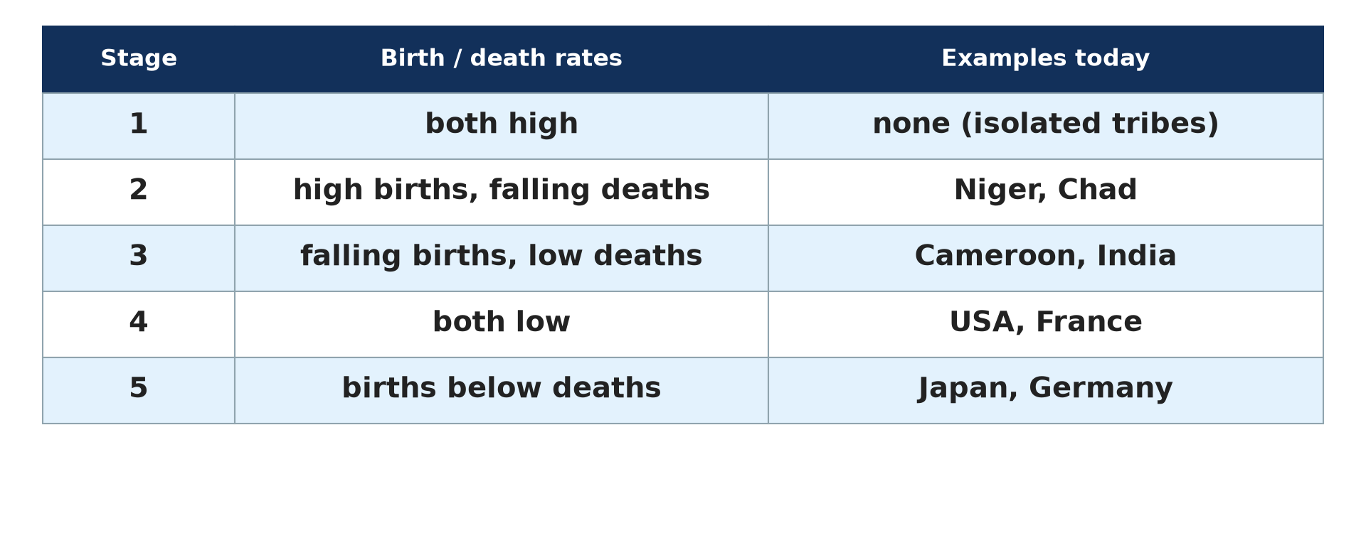
2. STAGES
Activity 2
The stages and examples.
Notes:
Activity 2. Look carefully at this diagram: the stages and examples. Observe every detail before I ask the question.

Slide 24
2. STAGES
Activity 2: Question
In which stage are Japan and Germany?
Notes:
Here is the question for Activity 2: In which stage are Japan and Germany? Take one minute to think and write your answer in your rough notebook.

Slide 25
2. STAGES
Activity 2: Answer
Stage 5 (declining).
Notes:
Let us check the answer together. Stage 5 (declining).

Slide 26
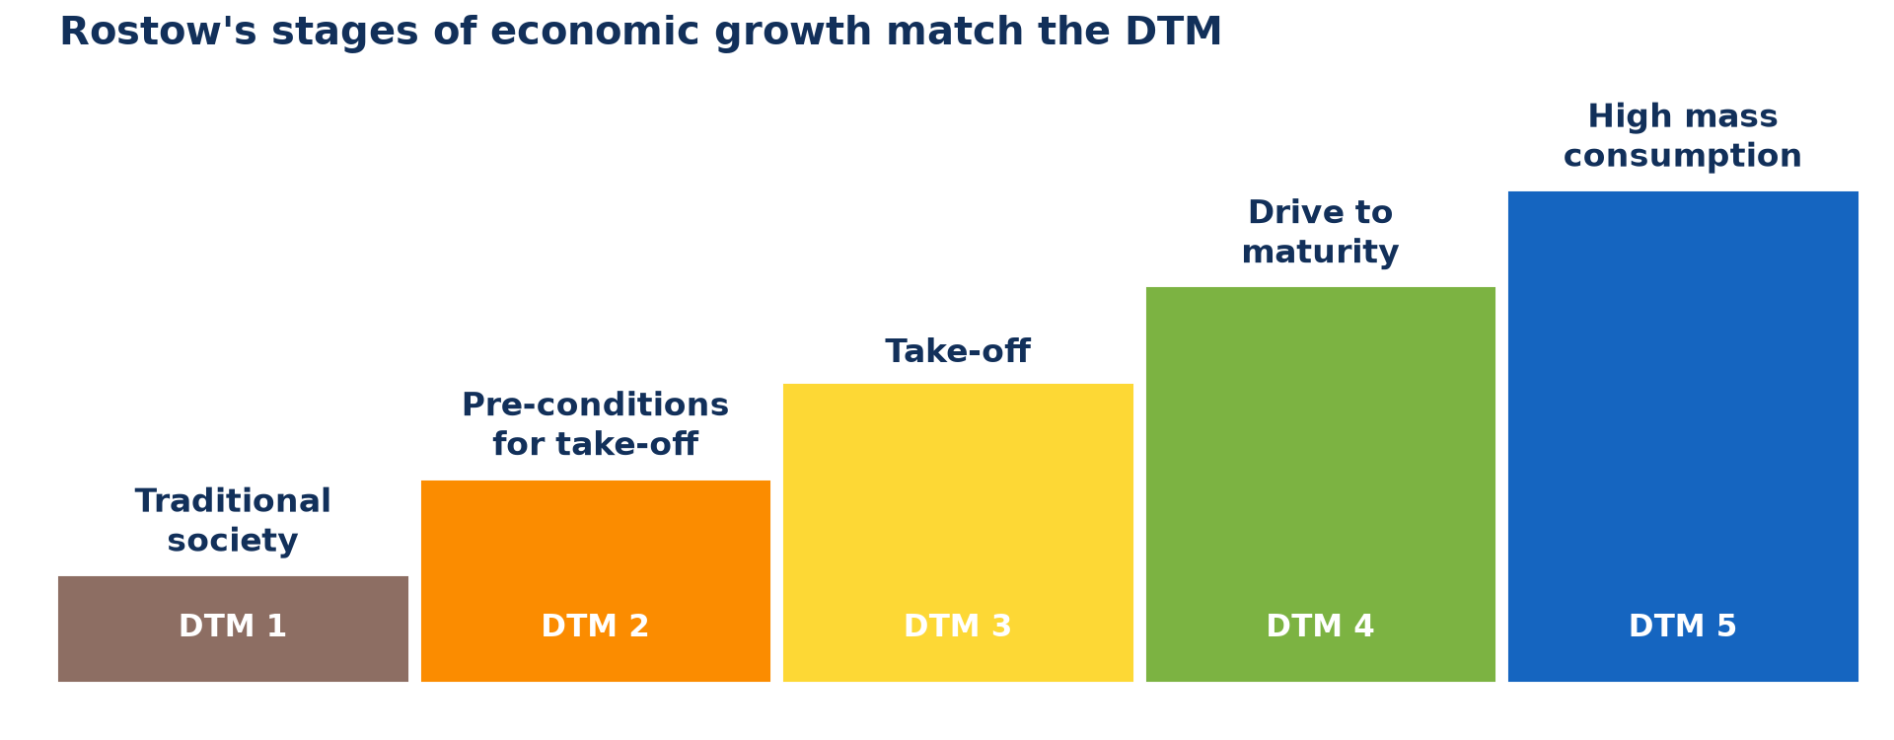
2. STAGES
Activity 3
Rostow's stages of growth.
Notes:
Activity 3. Look carefully at this diagram: rostow's stages of growth. Observe every detail before I ask the question.

Slide 27
2. STAGES
Activity 3: Question
Which stage of Rostow matches Stage 4 of the DTM?
Notes:
Here is the question for Activity 3: Which stage of Rostow matches Stage 4 of the DTM? Take one minute to think and write your answer in your rough notebook.

Slide 28
2. STAGES
Activity 3: Answer
The age of high mass consumption.
Notes:
Let us check the answer together. The age of high mass consumption.

Slide 29
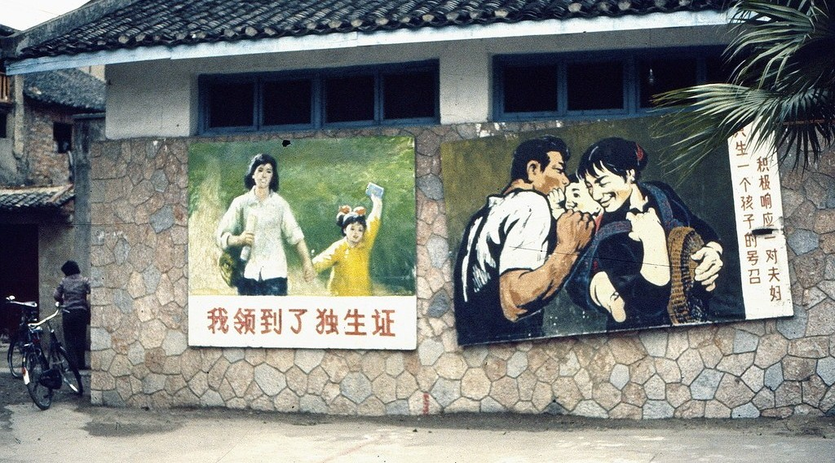
3. APPRAISAL
Activity 4
A population policy.
Notes:
Activity 4. Look carefully at this picture: a population policy. Observe every detail before I ask the question.

Slide 30
3. APPRAISAL
Activity 4: Question
Why is China's one-child policy a problem for the model?
Notes:
Here is the question for Activity 4: Why is China's one-child policy a problem for the model? Take one minute to think and write your answer in your rough notebook.

Slide 31
3. APPRAISAL
Activity 4: Answer
The model does not take government policies into account.
Notes:
Let us check the answer together. The model does not take government policies into account.

Slide 32
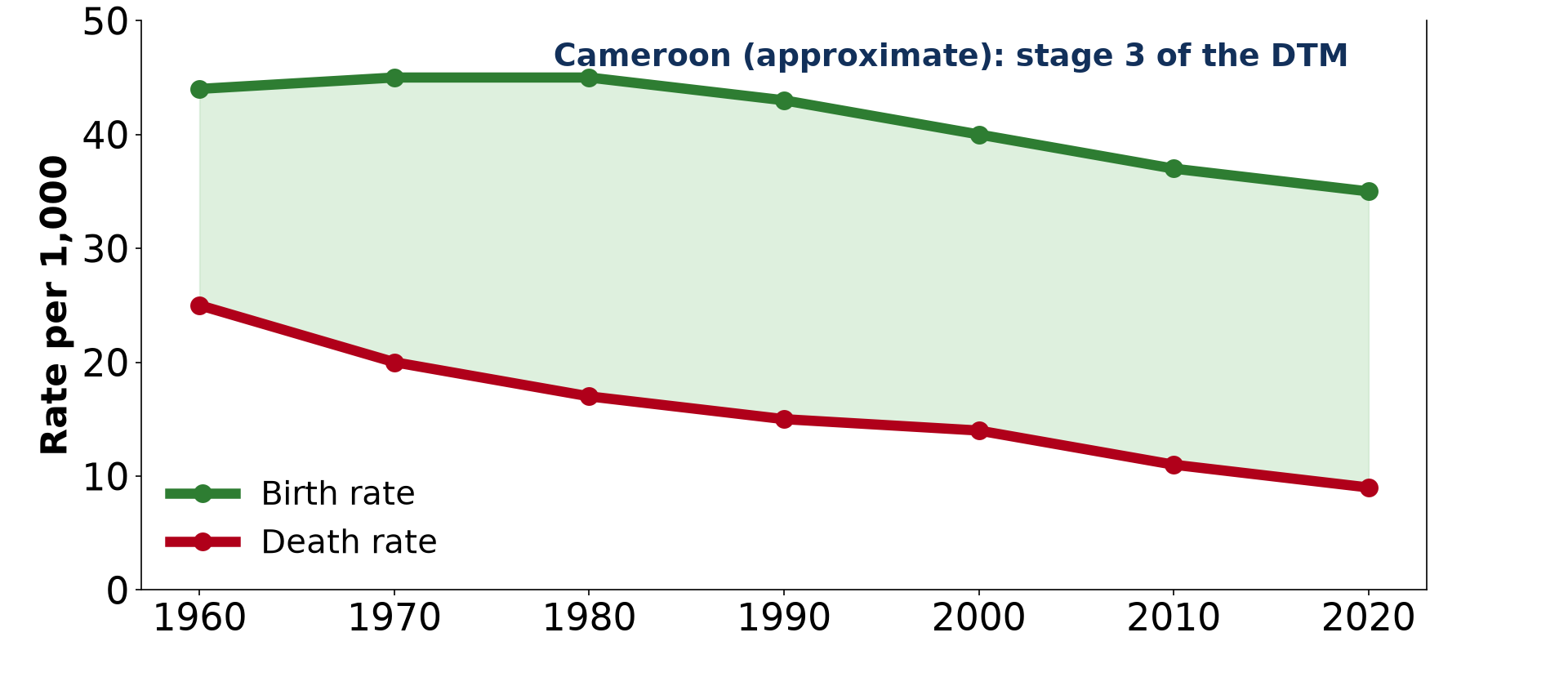
4. CAMEROON
Activity 5
Birth and death rates of Cameroon.
Notes:
Activity 5. Look carefully at this diagram: birth and death rates of Cameroon. Observe every detail before I ask the question.

Slide 33
4. CAMEROON
Activity 5: Question
Why is the population of Cameroon still growing fast?
Notes:
Here is the question for Activity 5: Why is the population of Cameroon still growing fast? Take one minute to think and write your answer in your rough notebook.

Slide 34
4. CAMEROON
Activity 5: Answer
The birth rate is still much higher than the death rate.
Notes:
Let us check the answer together. The birth rate is still much higher than the death rate.

Slide 35
BOARD SUMMARY
Board Summary
Topic: Population Change over Time (Population Growth)
Sub-topic: Population Growth
Lesson 12: The Demographic Transition Model
Notes:
Now we are going to copy the board summary. Write the title and the headings neatly in your notebooks. I will give you enough time for each slide, so do not rush.

Slide 36
BOARD SUMMARY
DEFINITIONS
The key terms of this lesson are defined as follows:
Demographic transition model (DTM): It is a model showing how birth rates, death rates and population change as a country develops.
Natural increase: It is the gap between the birth rate and the death rate.
Notes:
Let us copy the definitions. The key terms of this lesson are defined as follows. On this slide we have Demographic transition model (DTM) and Natural increase. Write each point on a new line, with the key term first, and explain it in your own words when we revise. When you finish, we go to the next slide.

Slide 37
BOARD SUMMARY
DEFINITIONS (continued)
Rostow's model: It is a model of five stages of economic growth, from traditional society to high mass consumption.
Notes:
We continue with the definitions. On this slide we have Rostow's model. Write each point on a new line, with the key term first, and explain it in your own words when we revise.

Slide 38
BOARD SUMMARY
1. Meaning of the Model
The demographic transition model is explained as follows:
Origin: The model is based on the history of Western Europe and North America during industrialisation. It was proposed by Warren Thompson in 1929 and developed by Frank Notestein.
Illustration: the demographic transition model
Notes:
Let us copy Meaning of the Model. The demographic transition model is explained as follows. Copy the point on Origin on the left, then draw the diagram on the right: the demographic transition model. Give it a title and label it clearly.

Slide 39
BOARD SUMMARY
1. Meaning of the Model
Principle: As a country develops, death rates fall first and birth rates fall later. Population growth therefore rises and then slows down.
Notes:
We continue with Meaning of the Model. Copy the point on Principle: write the key term first, then its explanation.

Slide 40
BOARD SUMMARY
1. Meaning of the Model
Link with Rostow's model: The five demographic stages can be linked with the five stages of economic growth of Rostow. Each fall in birth or death rates goes with a change in the economy and society.
Illustration: Rostow's model
Notes:
Copy the point on Link with Rostow's model on the left, then draw the diagram on the right: rostow's model. Give it a title and label it clearly.

Slide 41
BOARD SUMMARY
2. The Stages of the Model
A) Stages 1 and 2
The first two stages have the following characteristics:
Stage 1, high stationary: Birth and death rates are both very high (35 to 45 per 1,000), so growth is slow and irregular. It is a traditional farming society with famine, disease and high infant mortality, like Rostow's traditional society, and only isolated groups remain in it today.
Notes:
Let us copy Stages 1 and 2. The first two stages have the following characteristics. Copy the point on Stage 1, high stationary: write the key term first, then its explanation.

Slide 42
BOARD SUMMARY
2. The Stages of the Model
A) Stages 1 and 2
Stage 2, early expanding: Death rates fall quickly because health, food supply and sanitation improve, while birth rates stay high. The population grows very fast as industry and towns begin, like Rostow's pre-conditions and take-off, as in Niger and Chad.
Illustration: countries at each stage
Notes:
Copy the point on Stage 2, early expanding on the left, then draw the diagram on the right: countries at each stage. Give it a title and label it clearly.

Slide 43
BOARD SUMMARY
2. The Stages of the Model
B) Stages 3, 4 and 5
The last three stages have the following characteristics:
Stage 3, late expanding: Birth rates fall quickly and death rates slowly, so growth is still strong but slows down, as in India and Brazil. Towns and industry grow and women gain education and contraception, like Rostow's drive to maturity.
Notes:
Let us copy Stages 3, 4 and 5. The last three stages have the following characteristics. Copy the point on Stage 3, late expanding: write the key term first, then its explanation.

Slide 44
BOARD SUMMARY
2. The Stages of the Model
B) Stages 3, 4 and 5
Stage 4, low stationary: Birth and death rates are both low, so growth is very slow or zero, as in the USA and France. It corresponds to Rostow's age of high mass consumption.
Notes:
We continue with Stages 3, 4 and 5. Copy the point on Stage 4, low stationary: write the key term first, then its explanation.

Slide 45
BOARD SUMMARY
2. The Stages of the Model
B) Stages 3, 4 and 5
Stage 5, declining: Birth rates fall below death rates, so the population declines and ages. Japan, Germany and Italy are in this stage.
Notes:
We continue with Stages 3, 4 and 5. Copy the point on Stage 5, declining: write the key term first, then its explanation.

Slide 46
BOARD SUMMARY
3. Appraisal of the Model
A) Strengths
The model has the following strengths:
A simple framework: It gives a simple way to understand how population changes with development. It is easy to apply to most countries and to compare them.
Notes:
Let us copy Strengths. The model has the following strengths. Copy the point on A simple framework: write the key term first, then its explanation.

Slide 47
BOARD SUMMARY
3. Appraisal of the Model
A) Strengths
The role of development: It shows the importance of social and economic factors, such as health, education and urbanisation. It helps to predict how the population of a country will change.
Notes:
We continue with Strengths. Copy the point on The role of development: write the key term first, then its explanation.

Slide 48
BOARD SUMMARY
3. Appraisal of the Model
B) Weaknesses
The model has the following weaknesses:
It is Eurocentric: It is based on the history of Western countries. In Africa, deaths fell because of imported medicine, not because of industrialisation, so the stages do not happen in the same way.
Notes:
Let us copy Weaknesses. The model has the following weaknesses. Copy the point on It is Eurocentric: write the key term first, then its explanation.

Slide 49
BOARD SUMMARY
3. Appraisal of the Model
B) Weaknesses
It ignores other causes: It does not include wars, epidemics such as HIV/AIDS, migration or policies such as China's one-child policy. These can change population very quickly.
Illustration: the one-child policy
Notes:
Copy the point on It ignores other causes on the left, then draw the diagram on the right: the one-child policy. Give it a title and label it clearly.

Slide 50
BOARD SUMMARY
3. Appraisal of the Model
B) Weaknesses
Time scales and stage 5: Countries pass through the stages at very different speeds, much faster today than Europe did. The original model had only four stages, and the fifth was added when some countries began to decline.
Notes:
We continue with Weaknesses. Copy the point on Time scales and stage 5: write the key term first, then its explanation.

Slide 51
BOARD SUMMARY
4. Application to Cameroon
The model applies to Cameroon as follows:
Current stage: Cameroon is at the end of stage 2 and entering stage 3. Its death rate has fallen a lot, and its birth rate is beginning to fall.
Illustration: birth and death rates of Cameroon
Notes:
Let us copy Application to Cameroon. The model applies to Cameroon as follows. Copy the point on Current stage on the left, then draw the diagram on the right: birth and death rates of Cameroon. Give it a title and label it clearly.

Slide 52
BOARD SUMMARY
4. Application to Cameroon
A high birth rate: The birth rate is still about 35 per 1,000, because of traditions, early marriage and limited family planning. It is falling slowly in the towns.
Notes:
We continue with Application to Cameroon. Copy the point on A high birth rate: write the key term first, then its explanation.

Slide 53
BOARD SUMMARY
4. Application to Cameroon
A low death rate and rapid growth: The death rate is now about 8 per 1,000 thanks to vaccination, health posts and boreholes. The gap between births and deaths gives a growth of about 2.6 % a year.
Notes:
We continue with Application to Cameroon. Copy the point on A low death rate and rapid growth: write the key term first, then its explanation.

Slide 54
BOARD SUMMARY
4. Application to Cameroon
Future: With more education for girls and better health care, births should fall further. Growth should then slow down as Cameroon moves through stage 3.
Notes:
We continue with Application to Cameroon. Copy the point on Future: write the key term first, then its explanation.

Slide 55
FORMATIVE EVALUATION
Evaluation 1
Describe Stage 2 of the demographic transition model.
Notes:
Now let us check what you have understood. Question 1: Describe Stage 2 of the demographic transition model. Answer in your exercise book.

Slide 56
FORMATIVE EVALUATION
Expected Answer
Death rates fall quickly while birth rates remain high, so the population grows very fast.
Notes:
The expected answer is: death rates fall quickly while birth rates remain high, so the population grows very fast. If you got it right, well done.

Slide 57
FORMATIVE EVALUATION
Evaluation 2
Give two weaknesses of the demographic transition model.
Notes:
Now let us check what you have understood. Question 2: Give two weaknesses of the demographic transition model. Answer in your exercise book.

Slide 58
FORMATIVE EVALUATION
Expected Answer
It is Eurocentric; it ignores wars, epidemics, migration and policies; countries move at different speeds (any two).
Notes:
The expected answer is: it is Eurocentric; it ignores wars, epidemics, migration and policies; countries move at different speeds (any two). If you got it right, well done.

Slide 59
REMEDIATION
Remediation
Fill in the blanks:
In Stage 1, birth and death rates are both ______.
Japan is in Stage ______.
Cameroon is entering Stage ______.
Notes:
For those who need more practice, fill in the blanks in your exercise book. The answers are: number 1, high; number 2, 5; number 3, 3.

Slide 60
HOMEWORK
Homework
Define migration.
Notes:
For your homework: Define migration. We shall correct it at the beginning of our next lesson.

Slide 61
NEXT LESSON
Next Lesson
Our next lesson will be on:
Lesson 13: Migration: Characteristics, Laws and Models
Notes:
Our next lesson will be on Lesson 13: Migration: Characteristics, Laws and Models. Thank you for your attention, and see you next time.

Slide 62
BILINGUAL GAME
Bilingual Game (Jeu Bilingue)
English | Français
Demographic transition | La transition démographique
Birth rate | Le taux de natalité
Death rate | Le taux de mortalité
Natural increase | L'accroissement naturel
Stage | Le stade
Socio-economic | Socio-économique
Notes:
Let us play the bilingual game. I say a word in English, and you give me the French word. Then we do the reverse.

Slide 63
LOGBOOK
Official Logbook (1/2)
Module / Topic | Population Change over Time (Population Growth)
Lesson Title | Lesson 12: The Demographic Transition Model
Expected Learning Outcomes | Define the demographic transition model. Describe the characteristics of its five stages. Link the stages with Rostow's stages of economic growth. Appraise the strengths and weaknesses of the model. Apply the model to Cameroon.
Competence | Learners are able to describe the stages of the demographic transition model, appraise it and apply it to Cameroon.
Notes:
I record this information in the official logbook of the class after the lesson.

Slide 64
LOGBOOK
Official Logbook (2/2)
Matter Taught | DEFINITIONS; Meaning of the Model; Stages 1 and 2; Stages 3, 4 and 5; Strengths; Weaknesses; Application to Cameroon.
Evaluation | Formative evaluation and remediation exercise.
Homework | Define migration.
Enrolment / Present / Absent | ____ / ____ / ____
Achievement | To be completed after the lesson.
Notes:
I complete the second page of the logbook: the matter taught, the evaluation, the homework and the attendance.

Slide 65
TEACHER'S NOTE
Teacher's Note
Timing: Homework correction, plan, objectives 8 min | Recall, situation, action 10 min | 5 activities 30 min | Board summary (copying) 30 min | Evaluation, remediation 10 min | Homework, next lesson 5 min | Logbook 7 min
Without the projector (Activity 1): draw the two lines on the board.
Without the projector (Activity 2): write the stages in a table.
Without the projector (Activity 3): draw the staircase.
Without the projector (Activity 4): discuss one weakness.
Without the projector (Activity 5): write Cameroon's rates on the board.
Notes:
This slide is for me, the teacher: it gives the timing of the lesson and what to do if the projector is not available.

Slide 66
REFERENCES
References
Geography Syllabus for Sixth Forms (Lower and Upper Sixth), MINESEC, 2019 — Module 4 (Population Geography).
Teacher's course notes: Mr KAMDEM E., Population Geography (USA), GBHS Garoua, 2026.
United Nations, World Population Prospects 2024.
Photo, Activity 4: “propaganda posters, one child policy” by kattebelletje, CC BY-NC 2.0, via Flickr (https://www.flickr.com/photos/97249369@N00/3349125321)
Diagrams and animations: drawn for this lesson (Geography Department).
Notes:
These are the references and picture credits used to prepare this lesson.

